Slide 1

18ECC205J – Analog and Digital Communication
Course Credit : 4
Theory : 9 Hours
1. Singh. R. P & Sapre. S. D, “Communication Systems: Analog & Digital,” 3rd edition, McGrawHill Education, Seventh Reprint, 2016. 2. Simon Haykin, “Communication Systems”, John Wiley & Sons, 4th Edition, 2008

Slide 2
Course Outline
ADC
1. Analog Modulation
2. Radio Transmitters and Receivers
3. Digital Modulation System and Baseband Detection
4. Passband Data Transmission
5. Spread Spectrum Techniques and Information theory Concepts

Slide 3
Unit 4 – Pass band Data Transmission
Overview of ASK, FSK, PSK
Generation, Signal Space Diagram and detection of FSK
Probability of Error for FSK
Generation, Detection, Signal Space Diagram of PSK
Probability of Error for PSK
Generation, signal space diagram and detection of QPSK
Probability of Error for QPSK
Generation, signal space diagram and detection of π/4 QPSK
Generation, signal space diagram and detection of QAM

Slide 4
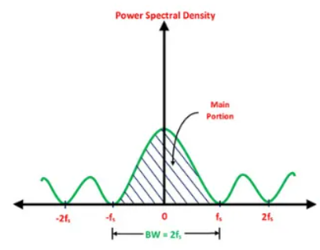
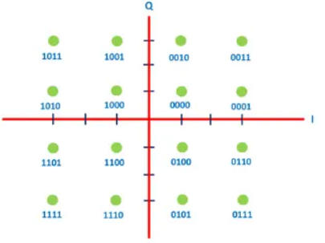
QAM - Quadrature Amplitude Modulation
QAM is defined as the modulation technique which is the combination of phase and amplitude modulation of a carrier wave into a single channel.
In other words, QAM transmits information by changing both the amplitude and phase of a carrier wave, thereby doubling the effective bandwidth.
QAM is also known as “quadrature carrier multiplexing”
In a QAM signal, the direct modulation of a carrier wave in quadrature is involved. As a name “quadrature” indicates that the phase difference between two carriers is 90゜but each having the same frequency.

Slide 5
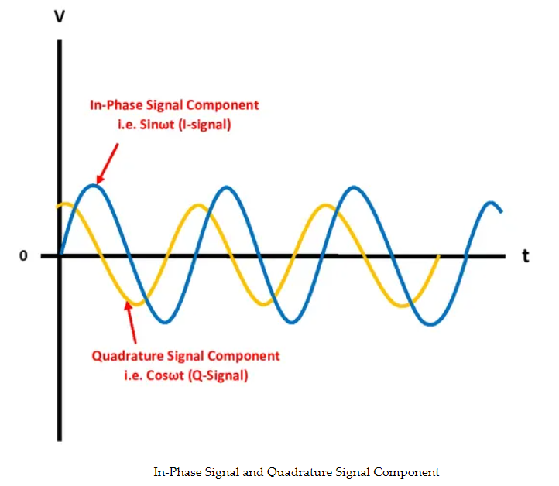
QAM - Quadrature Amplitude Modulation
One signal is called the in-phase “I” signal, and the other is called the quadrature “Q” signal.
Mathematically, one of the carrier signals can be represented by a sine wave (i.e. sinωt) and the other can be represented by a cosine wave (i.e. cosωt).
The two modulated carrier signals are transmitted together at the source and at the destination, these two carrier signals are demodulated (i.e. separated) independently.
To demodulate the signal coherent detection method is used.
The waveform of the QAM technique is shown below.
Name | Bits per symbol | Number of symbols
16 QAM | 4 | 2⁴ = 16
32 QAM | 5 | 2⁵ = 32
64 QAM | 6 | 2⁶ = 64
128 QAM | 7 | 2⁷ = 128
256 QAM | 8 | 2⁸ = 256

Slide 6
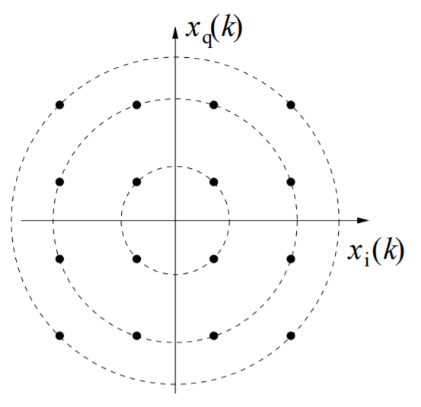
QAM – Quadrature Amplitude Modulation
QAM: combines features of PSK and ASK, uses both I and Q components, and is bandwidth very efficient
• Depending on the channel quality, 64-QAM, 128-QAM, or 256-QAM are possible.
An example of 16-QAM

Slide 7
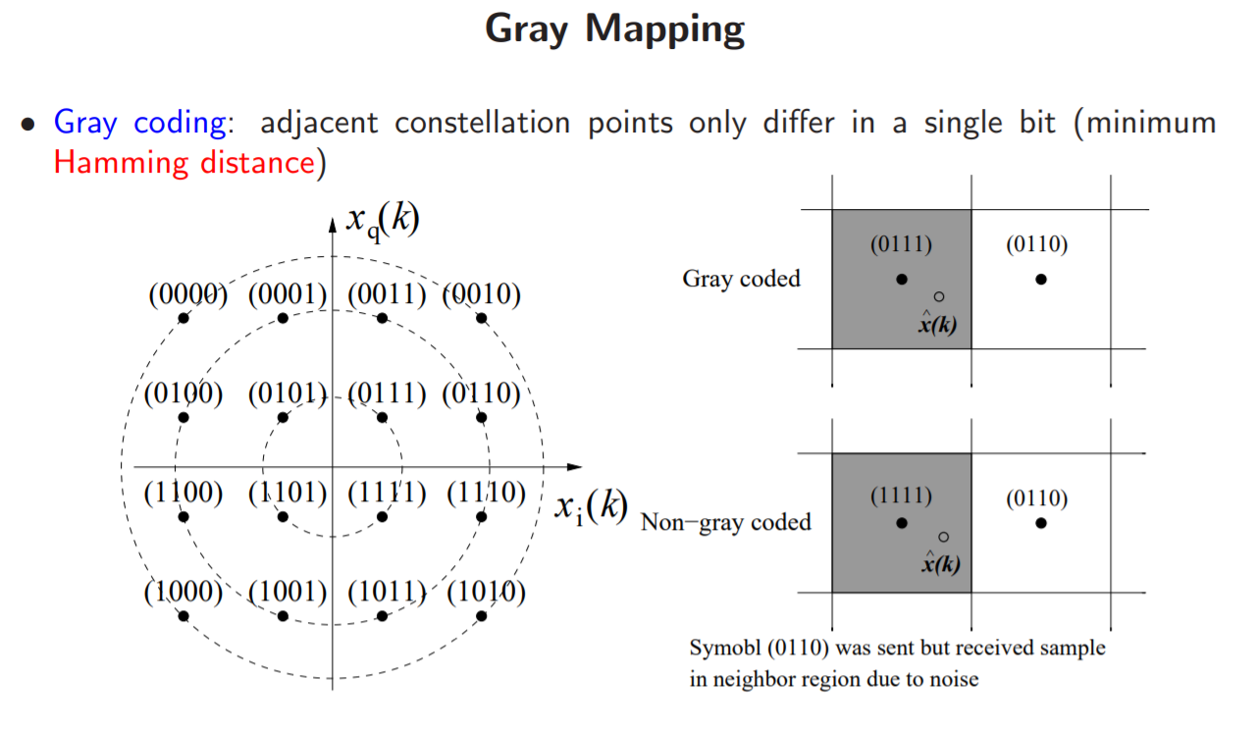
QAM – Quadrature Amplitude Modulation

Slide 8
QAM - Quadrature Amplitude Modulation
Analog QAM are typically used to allow more than one signal to be carried on a single carrier. It is the same as the AM (Amplitude Modulation) with two carrier signals transmitted together of the same frequency but out of phase with 90 degrees.
Analog QAM is used in the transmission of chroma (color) information in PAL and NTSC analog video television systems.
PAL - Phase Alternating Line is the video standard which is mostly used in the European and Asian countries
NTSC -National Television Standards Committee is the analog color television standard which is mostly used in South America and North America.
Digital QAM
In digital QAM schemes, to define the values of phase and amplitude different points can be used. This is known as a constellation diagram. Thus a constellation diagram is the set of possible message points.
16-QAM is considered as the lowest order QAM because 2-QAM is considered the same as for BPSK
4-QAM is the same as QPSK
The error-rate performance of 8-QAM is almost the same as that of 16-QAM hence it is not widely used.

Slide 9
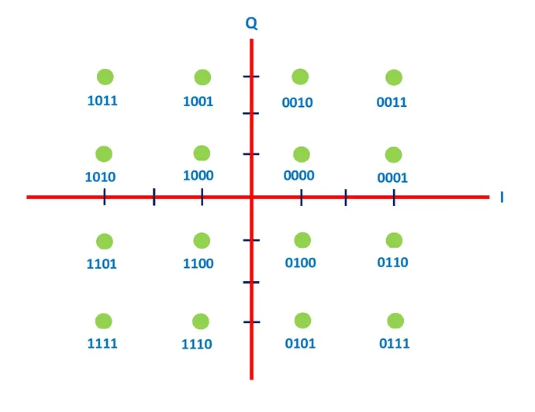
QAM - Quadrature Amplitude Modulation
QAM can be realized by using a constellation diagram.
In the constellation diagram, the constellation points are arranged in a square grid with equal horizontal and vertical distance.
The minimum distance between the constellation points is known as a Euclidean distance.
In the digital communications, data is usually in a binary form and it has two states 0 or 1, so the number of constellation points in the grid is usually a power of 2 i.e. 2, 4, 8, 16, 32………… the most common formats of QAM are16-QAM (2⁴), 32-QAM (2⁵), 64-QAM (2⁶), 128-QAM (2⁷) and 256-QAM (2⁸).
16-QAM Constellation diagram

Slide 10
QAM - Quadrature Amplitude Modulation
Advantages:
The primary benefit of QAM variants is efficient usage of bandwidth. This is because QAM represents more bits per carrier. For example, 256-QAM maps 8 bits per carrier and 16-QAM maps 4 bits per carrier
Disadvantages:
QAM is more susceptible to noise. This is because the transmission states are close together.
Applications:
Radio communications technologies ranging from Long-Term Evolution to Worldwide Interoperability for Microwave Access and Wi-Fi use different types of QAM.

Slide 11
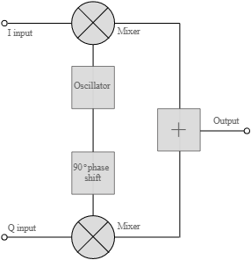
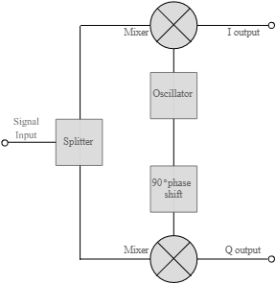
QAM – Modulator and Demodulator
QAM can be defined as it is s a modulation technique that is used to combine two amplitude modulated waves into a single channel to increase the channel bandwidth.
QAM I-Q Modulator Circuit
QAM I – Q Demodulator Circuit

Slide 12
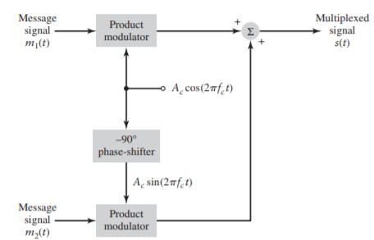
QAM – Modulator - Transmitter
QAM modulator - two carrier signals with a phase shift of 90° between them are amplitude modulated with the two data streams known as the I or In-phase and the Q or quadrature data streams. These are generated in the baseband processing area.
where m₁(t) and m₂(t) denote the two different message signals applied to the product modulators. The multiplexed signal occupies a channel bandwidth of 2W centered on the carrier frequency where W is the message bandwidth, assumed to be common to both.
A_{c} m₁(t) → in-phase component of the multiplexed band-pass signal
-A_{c} m₂(t) → quadrature component.
QAM I-Q Modulator Circuit

Slide 13
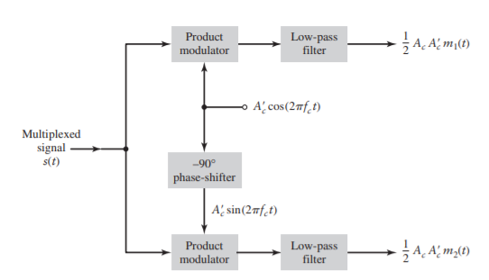

QAM – Demodulator - Receiver
Specifically, the multiplexed signal s(t) is applied simultaneously to two separate coherent detectors that are supplied with two local carriers of the same frequency, but differing in phase by -90゜.
$$\text{The} \text{output} \text{of} \text{the} \text{top} \text{detector} \text{is} \frac{1}{2} A_{c} A_{c}^{′}m_{1}(t)$$
$$\text{T}\text{he} \text{output} \text{of} \text{the} \text{bottom} \text{detector} \text{is} \frac{1}{2} A_{c} A_{c}^{′}m_{2}(t)$$
For the system to operate satisfactorily, it is important to maintain the correct phase and frequency relationships between the oscillator used to generate the carriers in the transmitter and the corresponding local oscillator used in the receiver.
QAM Demodulator Circuit

Slide 14

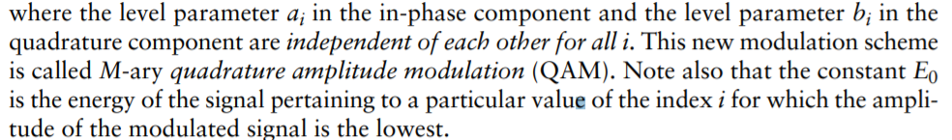
M-ary QAM

Slide 15
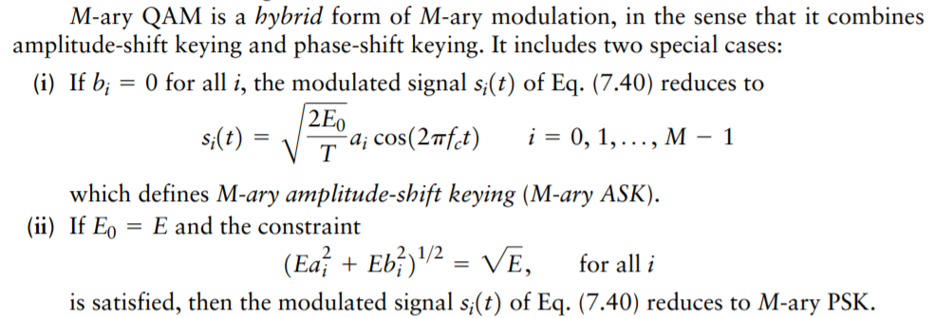
M-ary QAM

Slide 16
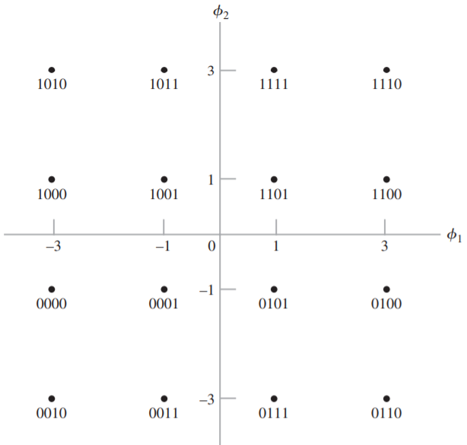
M-ary QAM – Signal Space Diagram
16 - QAM
Gray Encoded 6 - QAM

Slide 17
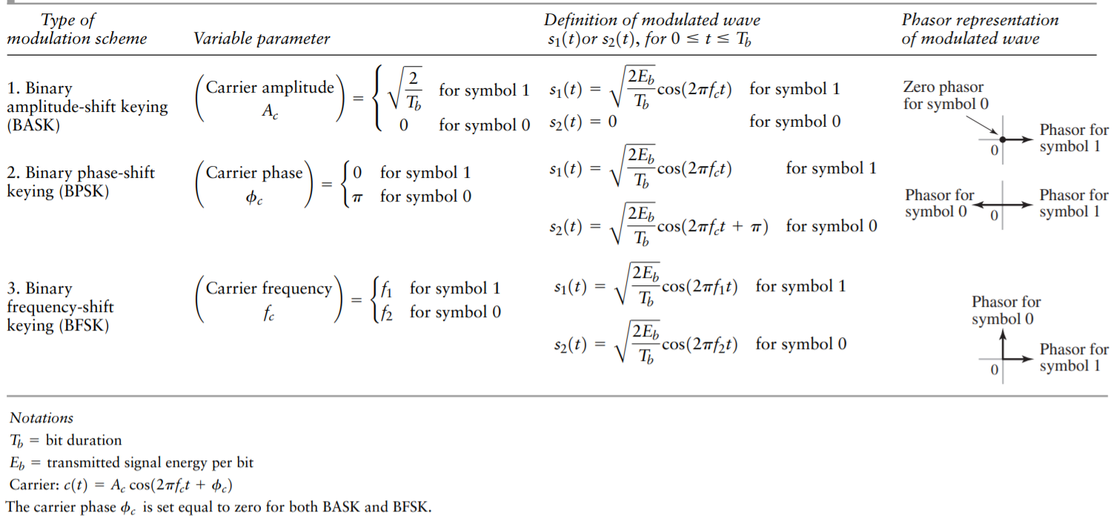
Review

